Slide 1
Introduction:
Robot:
This name was firstly used by a “Czechoslovakian” dramatist Karel Capek, 1921.
Aim:
Robots were designed to be perfect and tireless workers who performed manual labor for human beings. Industrial robots were intended to help human workers, not to replace them.
Characteristics:
Specialized machine tool: Consistent, unchanging, unthinking, untiring, hazardous jobs, and precise.

Slide 2
Types of robots
Parallel Robot: Consists of a moving platform and a fixed base interconnected by several links.
Examples:
6-DoF
3-DoF
Platform
Spherical
joints
Prismatic
joints
Base
Universal
joints
Revolute
joints

Slide 3
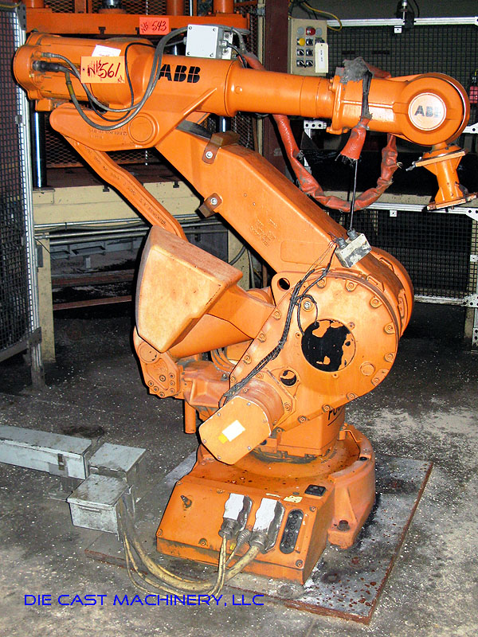
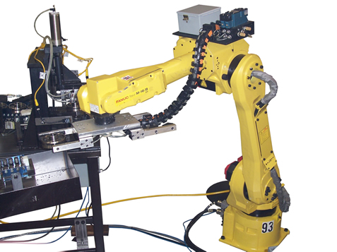
Types of robots
Serial Robot: Consists series of links inter-connected by joints that extend from a base to an end-effector.
Examples:
Revolute
joints
6-DoF

Slide 4
Types of robots (Comparison)
Parallel Robot:
Higher load
Smaller workspace
Serial Robot:
Lower load
Bigger workspace
This course!

Slide 5
Course Contents
Description of position and orientation
Direct kinematics (position)
Inverse kinematics
Kinematics (velocities, accelerations and static forces)
Dynamic analysis
Trajectory generation

Slide 6
Preface:
Manipulators/Robots consist of rigid links, which are connected by joints. That are instrumented with position sensors, which measure the relative position of neighboring links.
Revolute joints ➔ joint angles.
Prismatic joints ➔ joint offset/displacement.
Robot base ➔ joints ➔ links ➔ End-Effector (tool)
3D space (position & orientation) ➔ 6 DoF
1 joint ➔ 1 DoF ➔ robot of 6 joints (at least)

Slide 7
Chapter 2:
Description of position and orientation

